Slide 1
Creating Connections Through Rural Networks
Canadian Rural Revitalization Network Conference 2017
BC Rural Network – Directors: Danielle Robinson (University of Guelph) and Nicole Vaugeois (Vancouver Island University)
Notes:
How do we learn from each other for the betterment of our communities? Facilitated by the BC Rural Network (BCRN) as a forum to share the challenges and successes of rural networks within BC and across the country, this session focuses on the role grass-roots networking organizations play in bettering the lives of rural Canadians. CRRF conference participants are invited to take part in a discussion of key questions like: How are the tools, resources and experiences which are important to rural communities identified, coordinated and disseminated? How are linkages between communities, rural organizations, researchers and policy-makers built? How do rural networks operate effectively and evolve to meet changing community needs? This interactive session will be an opportunity for us to learn from each other about how to build and maintain rural networks and communities. The BCRN was established as a community driven non-profit in 2004 with the goal of building stronger rural and remote communities in BC by promoting better understanding of rural issues across all jurisdictions and developing responses to rural issues. Please see www.bcruralnetwork.ca for more information.

Slide 2
Session Agenda
Short Presentation on Rural Networks (15 minutes)
Origins across Canada
Their role and purpose
Successes
Challenges
The BC Story – the path forward
Other provincial stories?
Interactive learning session
What role can rural networks play at the provincial level?
What formats or structures exist for rural networks across Canada? What are the pros and cons with each?
What strategies can rural networks use to add value across Canada?

Slide 3
Rural networks

Slide 4
Networks
Networks are structures that support the process of networking – “the sharing, exchange or flow of ideas, information, knowledge, practice, experience (and sometimes resources) between people and around a common interest, or opportunity, to create value.”

Slide 5
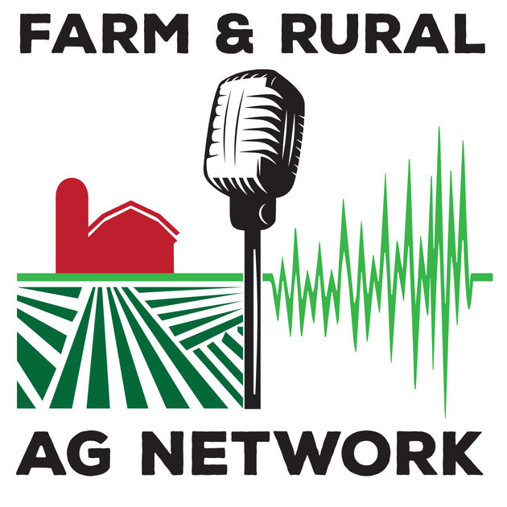
Rural networks
Rural networks exist to “improve the well-being, capacity and resilience of rural communities” and are built upon a web of interactions consisting of ‘nodes’ and ‘linkages’ where:
The ‘nodes’ are the individuals/organizations that form the network’s membership, and
The ‘linkages’ are the connections/relationships that exist between them.

Slide 6
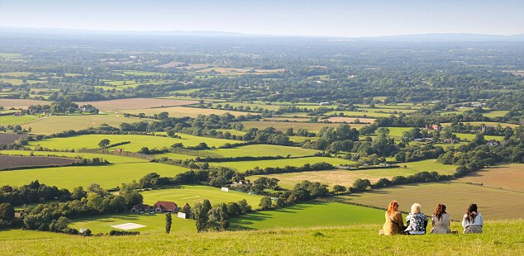
Role of rural networks
The most important reason for local people to access rural networks are to:
Receive information and advice
Share local learning and experiences
Develop creative ways to address local problems and needs
Identify sources of funding

Slide 7
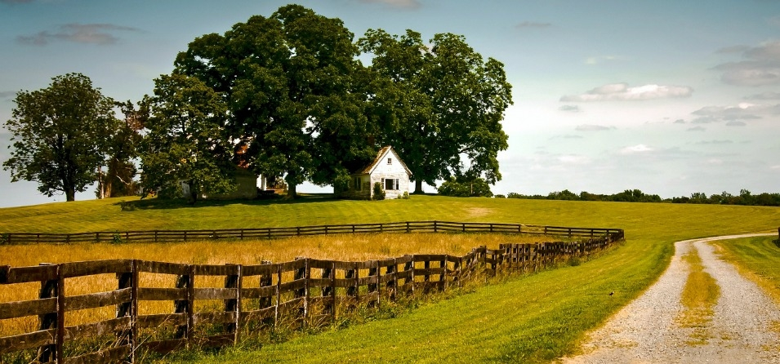
Rural networks vary by:
Focus – geographic reach, specific rural focus, specialist areas of expertise
Functions – practical advice, support, lobbying
Membership structure – formal or informal
Funding – reliance on public, private funding, fees to cover operational costs

Slide 8
Rural networks add value in 5 key ways:
Support cooperation and joint action – bring together actors that may not have cooperated before
Encourage the exchange of experience and knowledge – social learning and innovation
Develop social capital – trust, civic culture, ability to cooperate
Improve governance – democratic governance process, principles of openness, participation, accountability, effectiveness
Capacity building and training – targeted actions that complement social learning

Slide 9
A variety of challenges exist for rural networks
Limited resources/staff time
Geographic distance and the challenges of using technology to connect in rural areas
Geographic focus or theme focus that creates limiting silos
Territorial issues/competing for funding
Collaboration fatigue and volunteer fatigue
In addition, rural networks often rely on unstable funding sources and are subject to the changing policies of senior governments that fail to take a holistic and cross sector perspective of rural policy and development. The downsizing of the Federal Rural Secretariat, and many other Provincial and Territorial programs, exemplify this challenge.

Slide 10
Networks across Canada
Founded in 1989, the Canadian Rural Revitalization Foundation (CRRF) contributes to the revitalization and sustainability of rural Canada through rural research and knowledge dissemination engages collaboratively with rural stakeholders.
There are presently around twenty university based rural research centres across Canada
Rural networks exist in some provinces and for some sectors

Slide 11
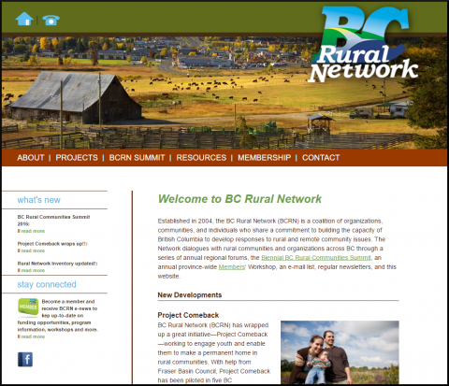
The BC Rural Network Story

Slide 12
The BC Rural Network (BCRN) was established in 2004 as a coalition of organizations, communities, and individuals who share a commitment to building the capacity of British Columbia to develop responses to rural and remote community issues. The BCRN aimed to achieve this by:
Acting as a coordinating body for the dissemination of information, tools, and resources of importance to rural and remote communities in British Columbia,
Acting as a catalyst to build linkages between communities, rural organizations, and policy-makers who work on issues of importance to rural and remote communities in British Columbia.
Improving awareness of the current work of existing rural groups and organization in BC by providing a forum for rural and remote communities and organizations to voice concerns and issues, and learn from each other.

Slide 13
BCRN is reassessing its role in building stronger rural and remote communities in BC given the current provincial landscape.
At its peak, the BCRN facilitated networks through a series of annual regional forums, the Biennial BC Rural Communities Summit, an annual province-wide Members‘ Workshop, an e-mail list, regular newsletters, and a website which included resources on governance, sectors, processes, projects and funding. BCRN continues to issue an e-newsletter, maintain its website, and partner on community projects at a small scale. The last BCRN Summit was in 2014; there is limited active involvement of a representative membership. Networking is a complex process and networks evolve and over time.

Slide 14
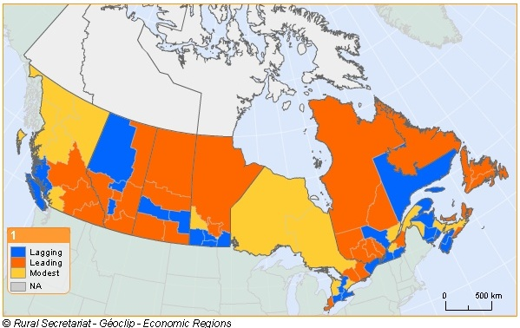
Other Provincial stories?

Slide 15
Interactive Problem solving

Slide 16
Think – Pair - Share
What role can rural networks play at the provincial level?
What formats or structures exist for rural networks across Canada? What are the pros and cons with each?
What strategies can rural networks use to add value across Canada? (i.e. to support cooperation and joint action, encourage the exchange of experience and knowledge, develop social capital, improve governance and build capacity)?

Slide 17
Report out – Insights gained?

Slide 18
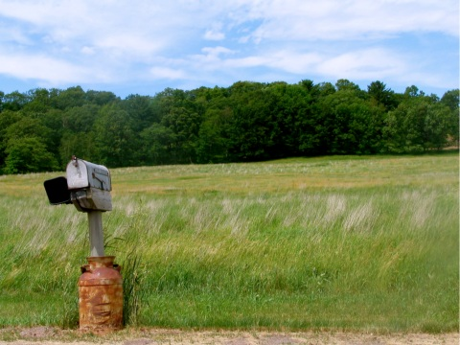
Closing thoughts
Thank you

