Slide 1



Examining New Environmental Governance Initiatives for Developing Country Small-Scale Fisheries: Fishery Improvement Projects in the African Context
BY
Richard Nyiawung & Dr. Paul Foley (PhD)
3rd World Small-Scale Fisheries Conferences, Chiang Mai Thailand, 22 -26, October, 2018

Slide 2
Outline
Introduction to FIPs
FIPs in the African Context
Gambian Sole fishery FIP
Research Area and Methods
Theory: Transnational Governance
Analysis
Actors’ Involvement
Interactions and Collaboration
Policy formulation and Challenges
Key Findings
Conclusions
Recommendations

Slide 3
Introduction
Global Fisheries and Seafood
Sustainability Challenges
Declining stocks
The Marine Stewardship Council (Eco-label)
Fishery Improvement Projects (FIPs)
Introduced late 2010s
Stakeholders involvement
Promotes sustainability and possibly ecolabelling

Slide 4
Source: Retrieved from the Coastal Resources Center of the University of Rhode Island (2014)

Slide 5
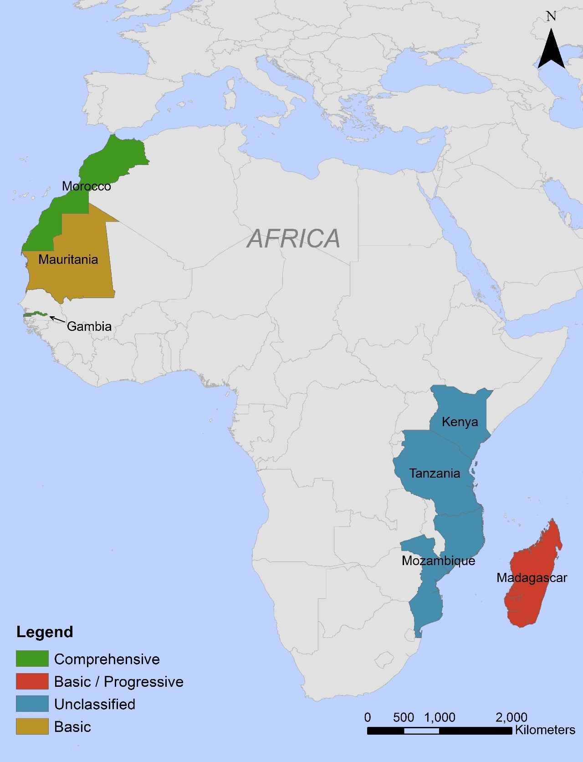
Africa’s FIP Distribution
Fisheryprogress.org, 2018

Slide 6
Research Area & Methods
Research Area
The Gambian Sole Fishery
Broader African FIPs
Madagascar Octopus
Tanzania Octopus
Mozambique Deep water
prawn

Slide 7
Methodology
Data Collection
Selection of key informants from African Union, NGOs, Governments, Consultants, and fishery associations from Grey literature
Snow Ball sampling/Skype Interviewing
16 key informant interviewed
7 from the broader African context
9 from the Gambian Sole
Secondary literature review from scholarly sources
Data Analysis
Categorization of the data into themes in Nvivo 11 pro
Analysis of Key themes using the political economy theory approached

Slide 8
Theoretical Framework
Transnational Governance Trends
The Transnationality of African FIPs
Power Differences in African FIPs
FIP Formulation Processes
Fishing Association
Government
International Actors

Slide 9
Analysis and Key Findings
Analysis
Multiple Actors Involvement
Financial Engagement
Institutional Collaborations and Interactions
Key Findings
International actors playing a major role in African FIPs
Governments seemingly weak and lack enthusiasm in the FIP processes and Activities
Local Fishing organizations and leaders are active but depends on international actors
More of an international top down financing
Lack of adequate local capacity and capabilities

Slide 10
Conclusion and Recommendations
Conclusion
Changes in governance and management of fisheries resources from multiple actors
Dependence on external funding for FIP activities
Technicality of FIP processes to facilitate fishers' comprehension
Poor government capacities and infrastructures
Recommendation
Improvements in capacities and capabilities
Governments need to step up and be more engaged
Encouraged domestic consumption rather than international –Food security
More engagement in activities that equals promotes sustainable livelihood of the communities
More research on FIPs needed in the African region

Slide 11
Thank You for your attention
Acknowledgements
Dr. Paul Foley (Supervisor)
Rural Policy Learning Commons (RPLC), Canada
The Organizers of the Conference

